Slide 1
Custom components pt 2 - hello world
Encapsulated, single-responsibility, reusable code

Slide 2

Contents
How do you make a web custom component?

Slide 3
What is a custom web component?
Custom web components are web components a developer can create and use just like regular web components

Slide 4
What is a custom web component?
A javascript class that:
extends the class HTMLElement
implements behaviour
defines a html tag string
It can be (re) used in any html application

Slide 5
What is a custom web component?
So it is like a Angular, React, Vue component?
No!
Angular (and React and Vue) components depend on their framework and cannot be re-used outside it.
But is does serve the same purpose!

Slide 6
How do you make a web custom component?
Assignment:
Use Vitejs to create a vanilla javascript project
Remove the counter.js code example
Add a HelloWorld component
Use the HelloWorld component in the template

Slide 7
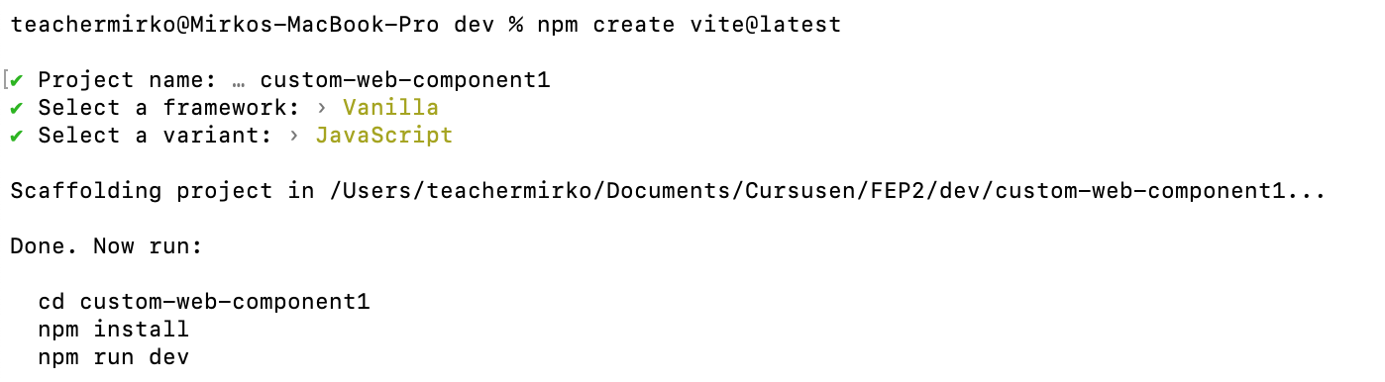
How do you make a web custom component?
We use vite to create a vanilla javascript project
Open a terminal window and navigate to your dev folder
Issue the following command:
npm create vite@latest
npm install

Slide 8
counter.js
Remove the file counter.js
Vite generates this as an example.

Slide 9
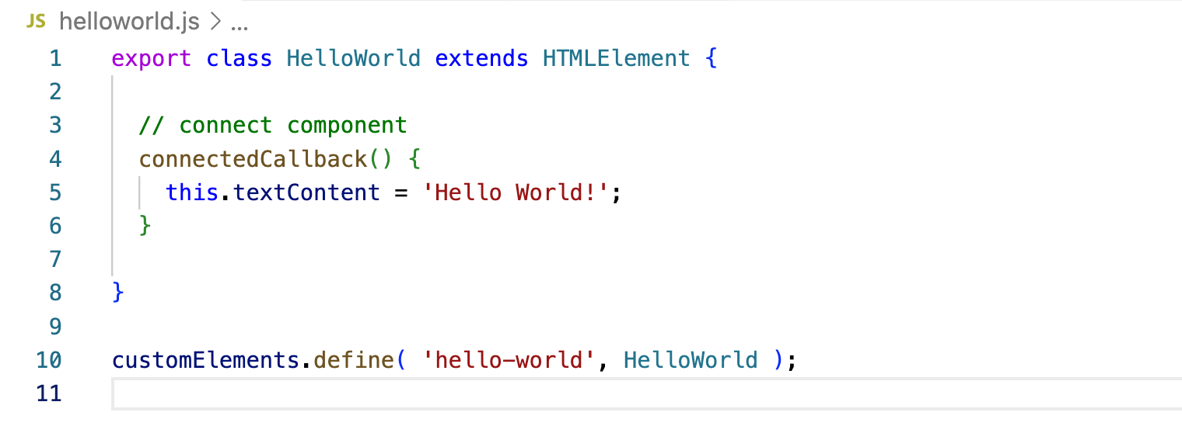
helloworls.js
Create a new file called helloworld.js
Create a class HelloWorld that extends HTMLElement and export it
Create a function connectedCallback()
The tag MUST HAVE
a hyphen -
Define the html tag for the custom component

Slide 10
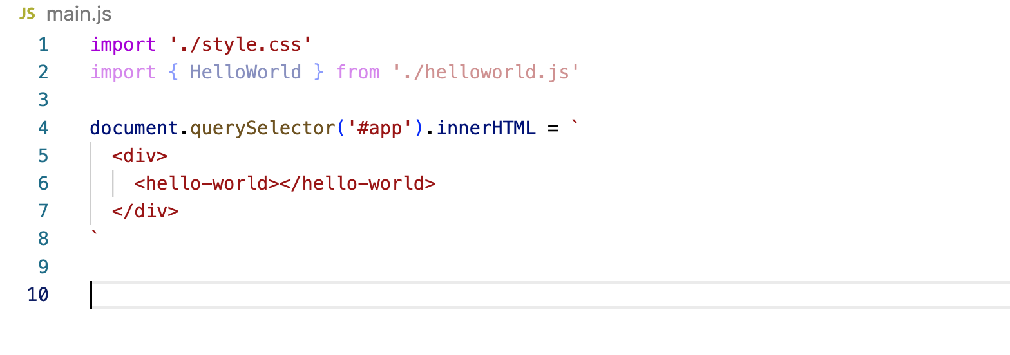
main.js
import the HelloWorld component
Use the custom component
Remove the reference to counter and superfluous code

Slide 11
Run the application
To run the application you only need to run the npm run dev command to start the dev server:
npm run dev
The dev server will be started on port 5173

Slide 12
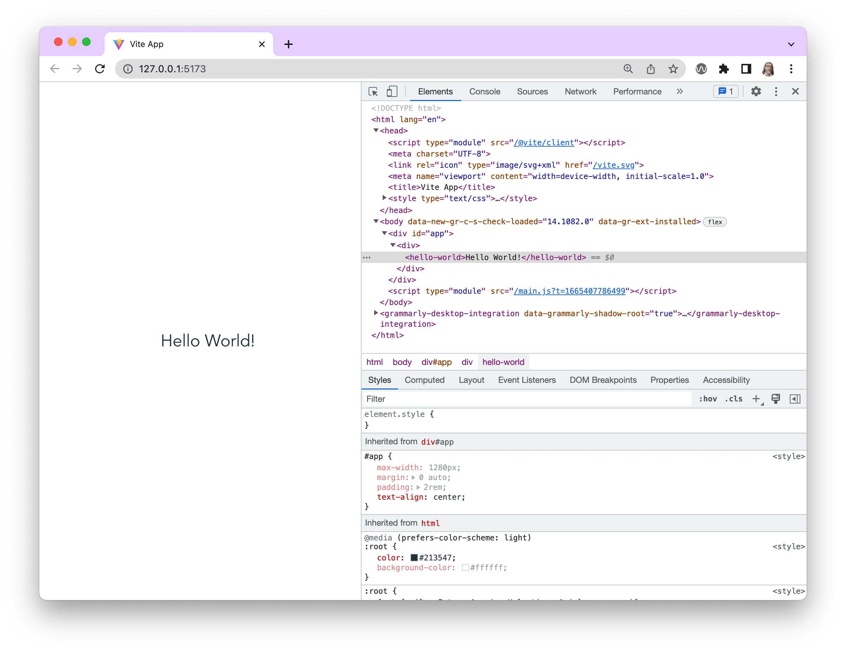
There is our hello world code
There is our hello world

Slide 13
Custom web component
You have just created your own custom html component!

Slide 14
Attributes
Html elements (components) can have attributes that specify how the element should work.
For example the type attribute in the <input> element specifies what type of data should be accepted by the input.
How do we implement this in custom components?

Slide 15

Attributes
We want to change the helloworld component in such a way that we can specify what we say hello to:
<hello-world-attr name="Mirko"></hello-world-attr>
Should result in:

Slide 16
Component hello-world-attr
Create a new file called helloworld-attributes.js
export class HelloWorldAttr extends HTMLElement {
}
customElements.define( 'hello-world-attr', HelloWorldAttr );

Slide 17
constructor()
The constructor is the function that is called when the object is created.
constructor() {
// When you define a constructor, ALWAYS call the super()
super();
// Set a default value for the name
this.name = 'World2';
}
ALWAYS call super()
Default value for world (in case the attribute is missing

Slide 18
connectedCallback()
This allows us to render the view whenever something has changed
The connectedCallback function is called when the component is added to the DOM
connectedCallback() {
// Call the render function
this.render();
}
render() {
// Use the name in the Hello string
this.textContent = `Hello ${this.name}!`;
}
We introduce a render function
Use the value of name here!

Slide 19
observedAttributes
The getter (!) observedAttributes returns an array with (html) attributes that the component ‘observes’ (tracks changes for)
static get observedAttributes() {
return ['name'];
}
We want to observe change to the attribute name

Slide 20
attributeChangedCallback
The attributeChangedCallback method is called when an ‘observed’ attribute changes value.
attributeChangedCallback(property, oldValue, newValue) {
if (oldValue === newValue) return;
this[ property ] = newValue;
this.render();
}
Use the render function to make the change visible
This is why we needed a render function

Slide 21
export class HelloWorldAttr extends HTMLElement {
static get observedAttributes() {
return ['name’];
}
constructor() {
// When you define a constructor, ALWAYS call the super()
super();
// Set a default value for the name
this.name = 'World2’;
}
// connect component
connectedCallback() {
// Use the name in the Hello string
this.render();
}
render() {
// Use the name in the Hello string
this.textContent = `Hello ${this.name}!`;
}
attributeChangedCallback(property, oldValue, newValue) {
if (oldValue === newValue) return;
this[ property ] = newValue;
this.render();
}
}
customElements.define( 'hello-world-attr', HelloWorldAttr );
Defines which attributes are observed
Executed when the object is created
Executed when the component is added to the DOM
Executed when an observed attribute changes value

Slide 22
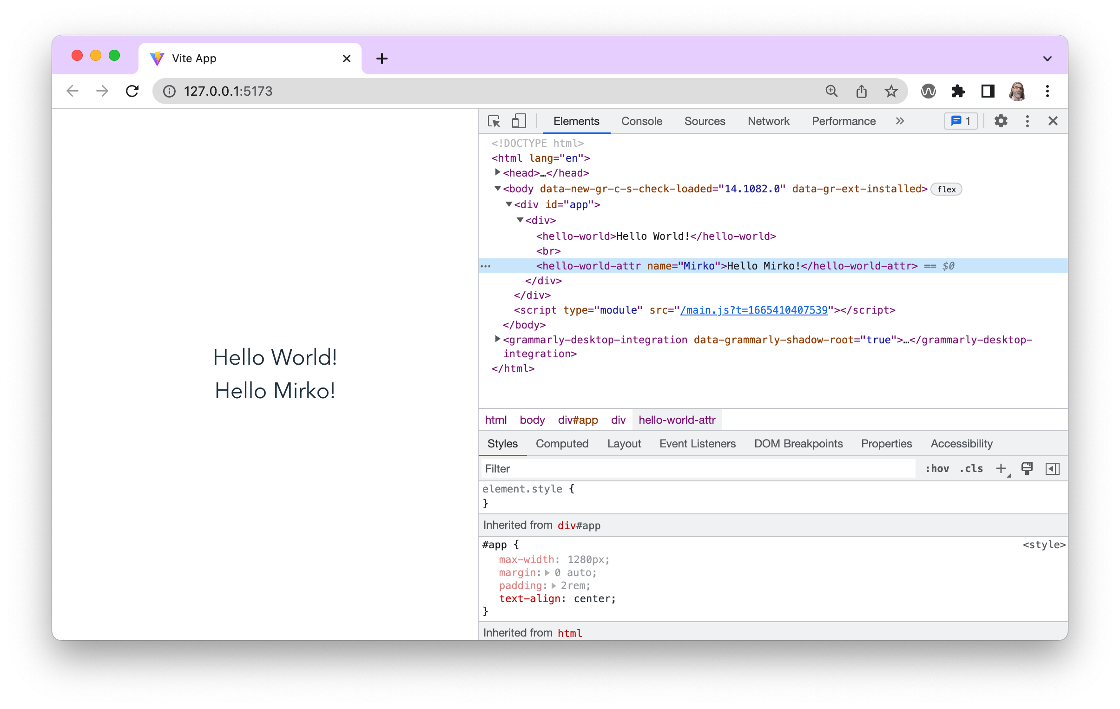

Slide 23
Attributes
Now change the name attribute in the browser…

Slide 24
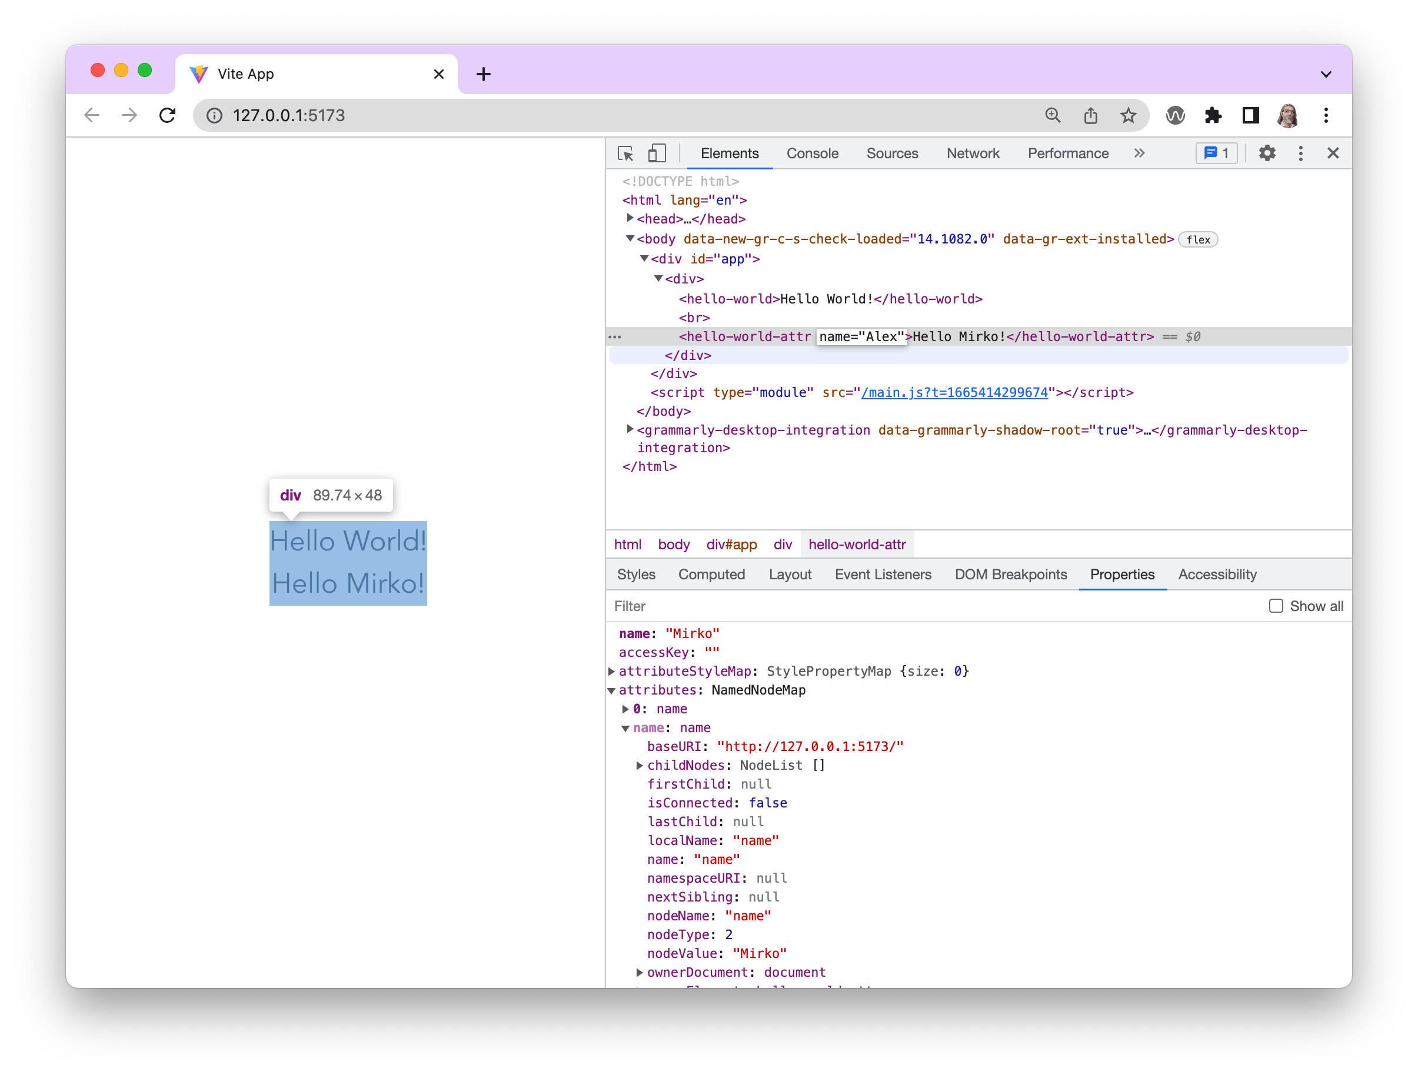
Change the attribute

Slide 25
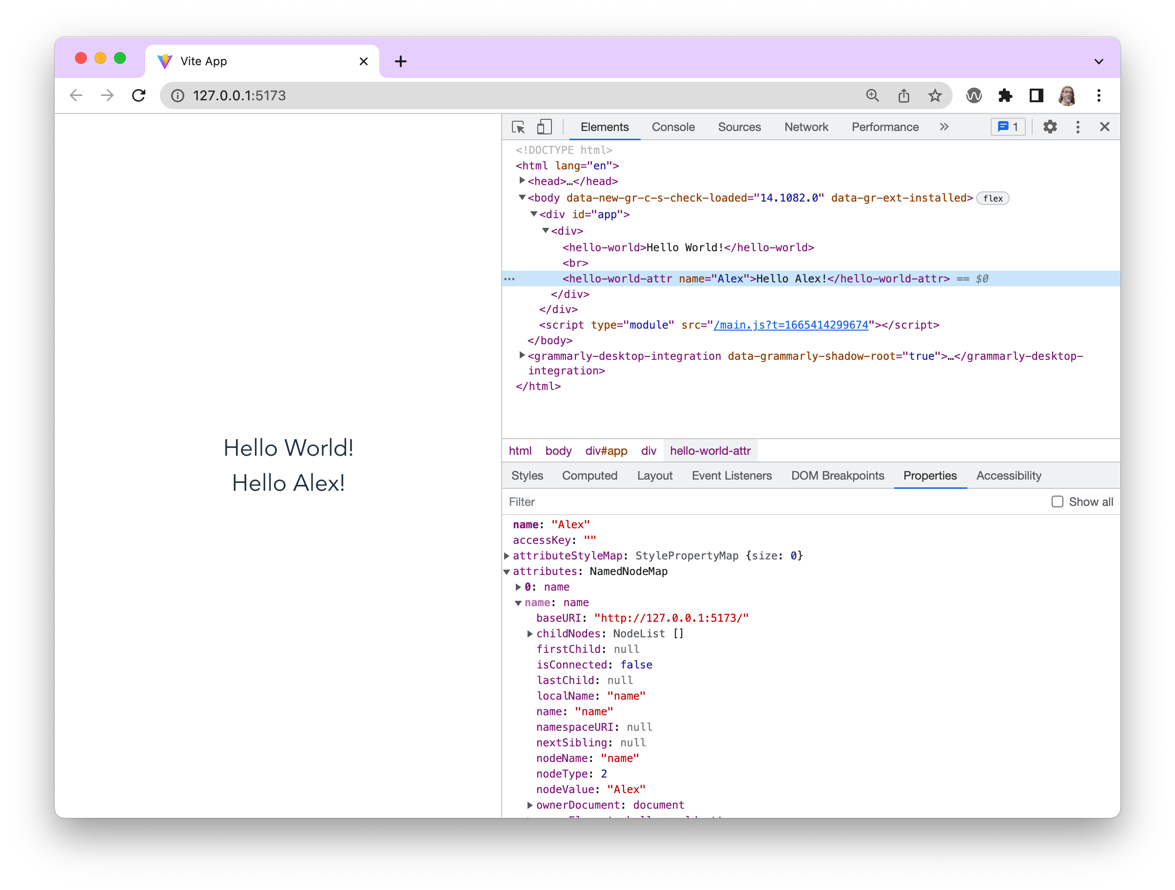
Change the attribute to Alex
Change become visible!

Slide 26
Conclusion
Custom web components are created using a javascipt class that extends HTMLElement
Custom web component behave just like regular web components (elements)
Data can be passed on using attributes

